Slide 1
Covid – 19 Vaccinations: Who will win the race toward Herd Immunity?
Analysts: Sherali Yadav, Tara Polli, Varnika Rachupally, Yong Yang, Paige Singleton

Slide 2
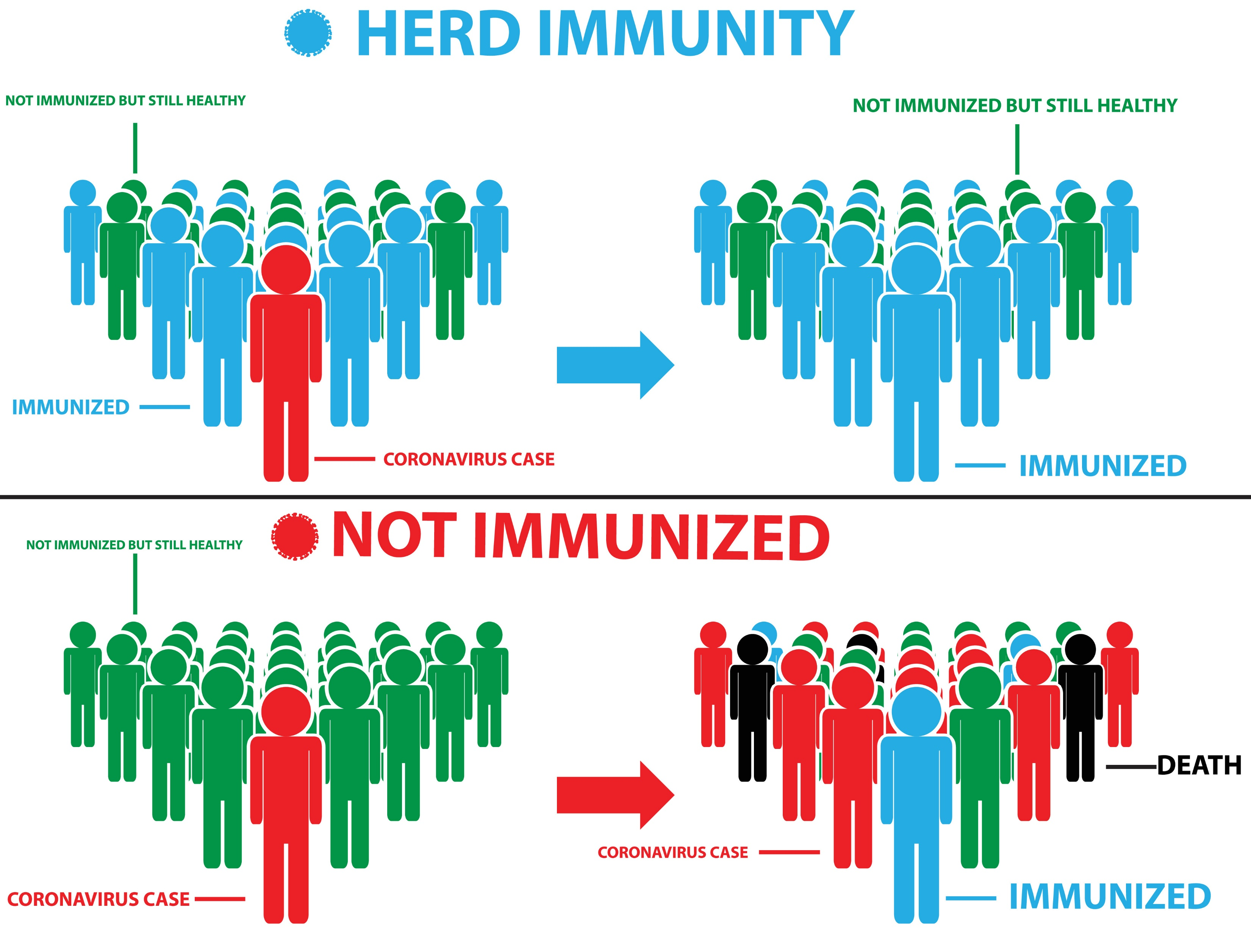
What is Herd Immunity?
“If we imagine the action of a vaccine not just in terms of how it affects a single body, but also in terms of how it affects the collective body of a community, it is fair to think of vaccination as a kind of banking of immunity. Contributions to this bank are donations to those who cannot or will not be protected by their own immunity. This is the principle of herd immunity, and it is through herd immunity that mass vaccination becomes far more effective than individual vaccination.” ― Eula Biss, On Immunity: An Inoculation

Slide 3
Interesting Questions

Slide 4
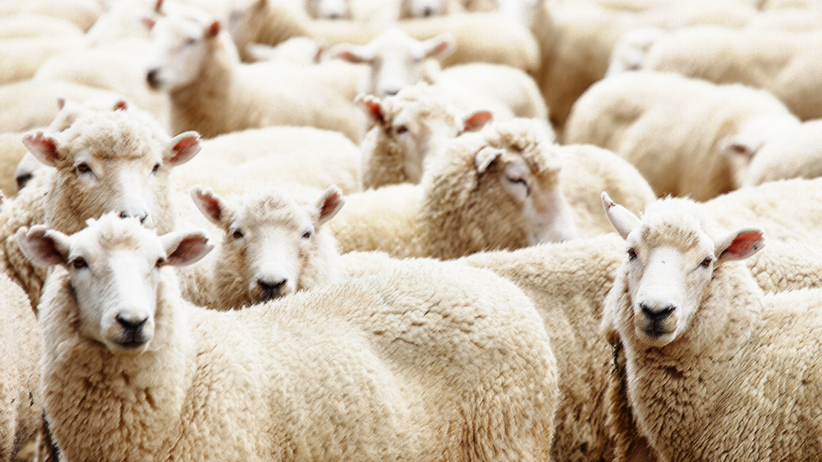
Interesting Questions
Which country or countries are on-track to achieve herd immunity?
Which country is the most successful in rolling out the COVID-19 vaccine and what vaccine(s) are they using?
For the top country, does a correlation exist between percent of people vaccinated and number of new cases?

Slide 5
Data Sources

Slide 6
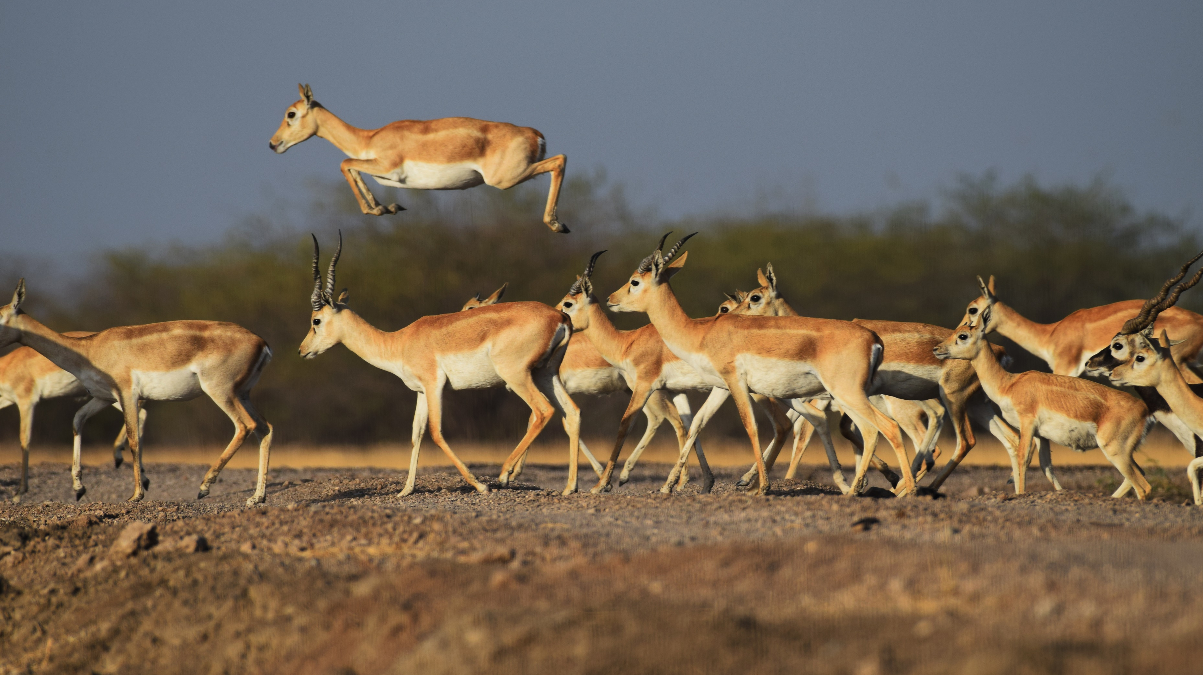
Data Sources
Coronavirus Pandemic (COVID – 19)
Wide range of worldwide Covid – 19 related data included deaths, cases, tests, hospitalizations, and vaccinations
https://ourworldindata.org/coronavirus
COVID – 19 World Vaccination Progress
“Daily and Total Vaccination for COVID-19 in the World” – vaccination data collected daily for those countries that release data.
https://www.kaggle.com/gpreda/covid-world-vaccination-progress

Slide 7
Exploration and Cleanup

Slide 8

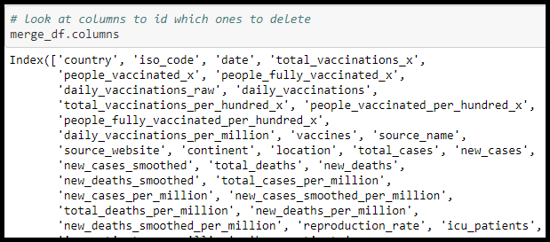
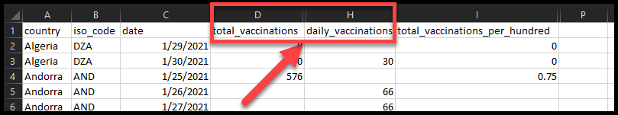
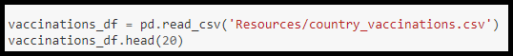
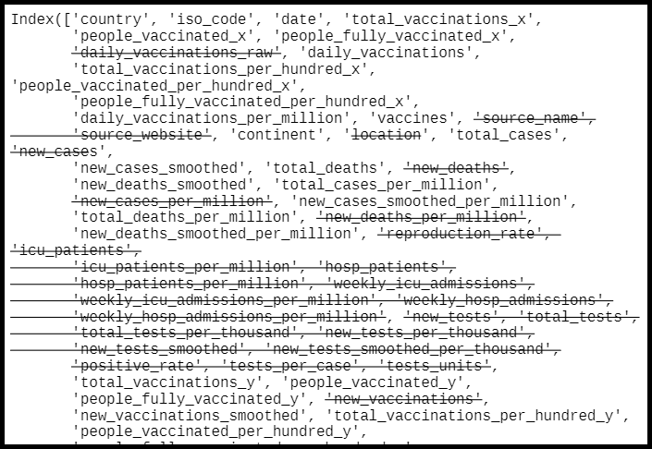
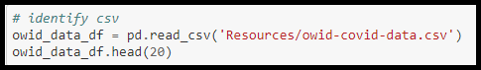
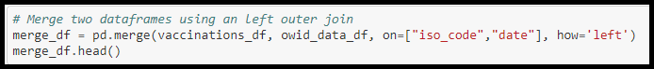
Exploration and cleanup

Slide 9
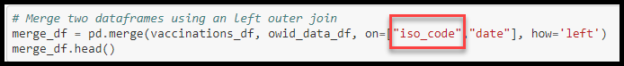
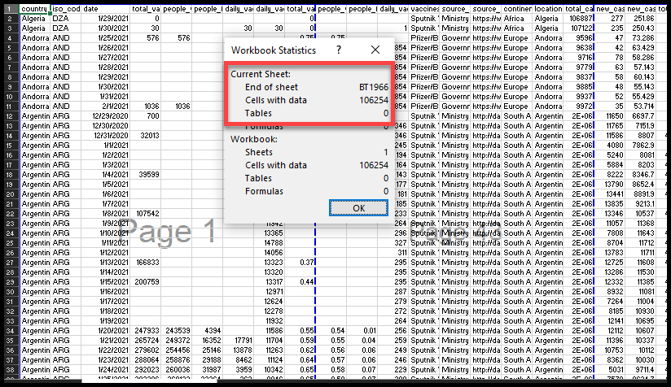
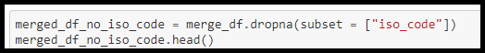
Exploration and cleanup
106,254 cells of data

Slide 10
Analysis

Slide 11

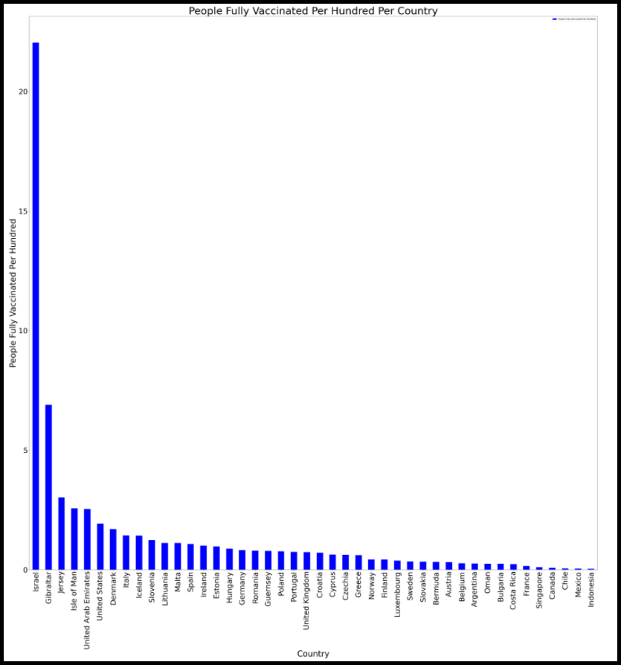
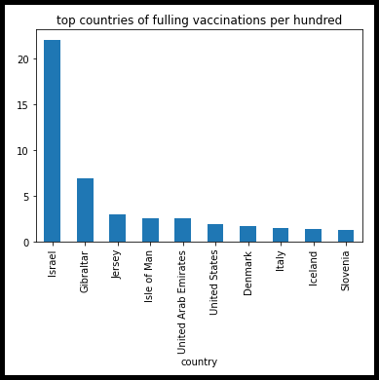
Top Countries
List of the top vaccines per hundred per country
Top Countries:
Israel
Gibraltar
Jersey
Isle of Man
United Arab Emigrates
What Happens if we look countries more closely?

Slide 12
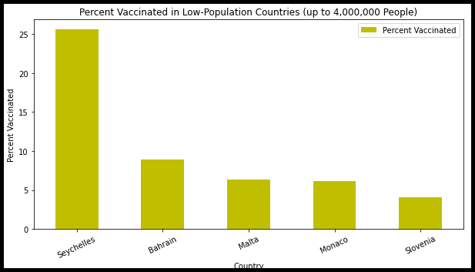
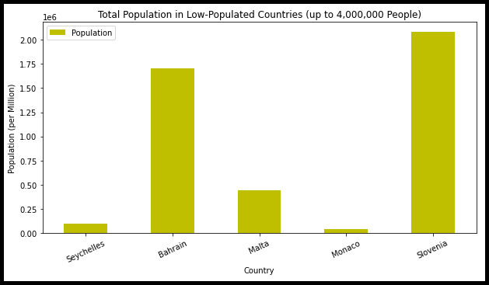
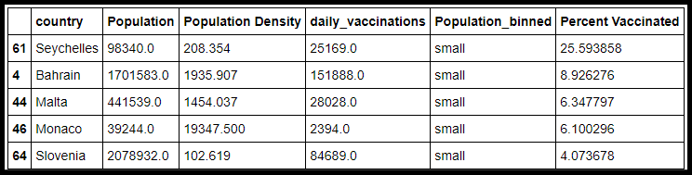
Small Countries
Does the size of the country matter?

Slide 13
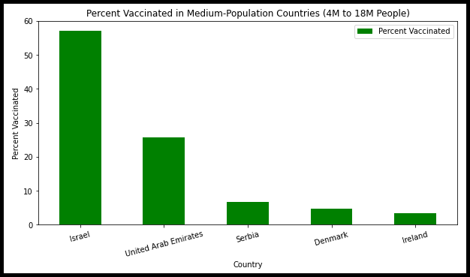
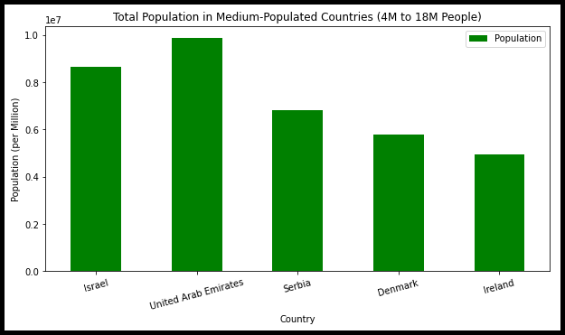
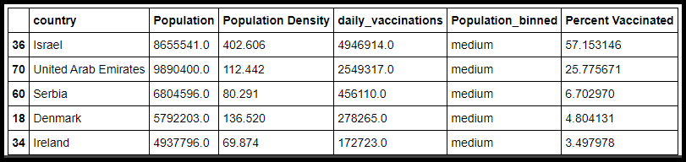
Medium Countries
Does the size of the country matter?

Slide 14
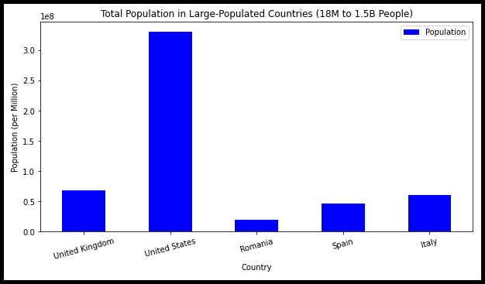
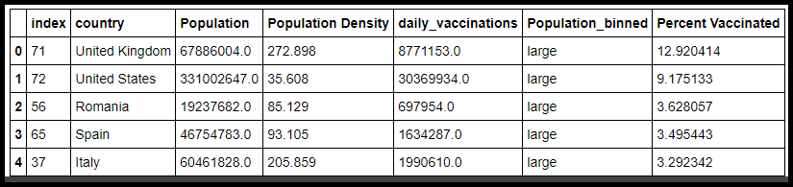
Large Countries
Does the size of the country matter?

Slide 15
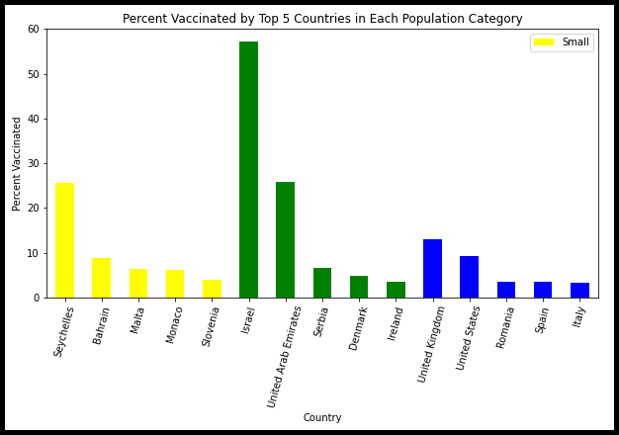
Countries
Does the size of the country matter?

Slide 16
Conclusions

Slide 17


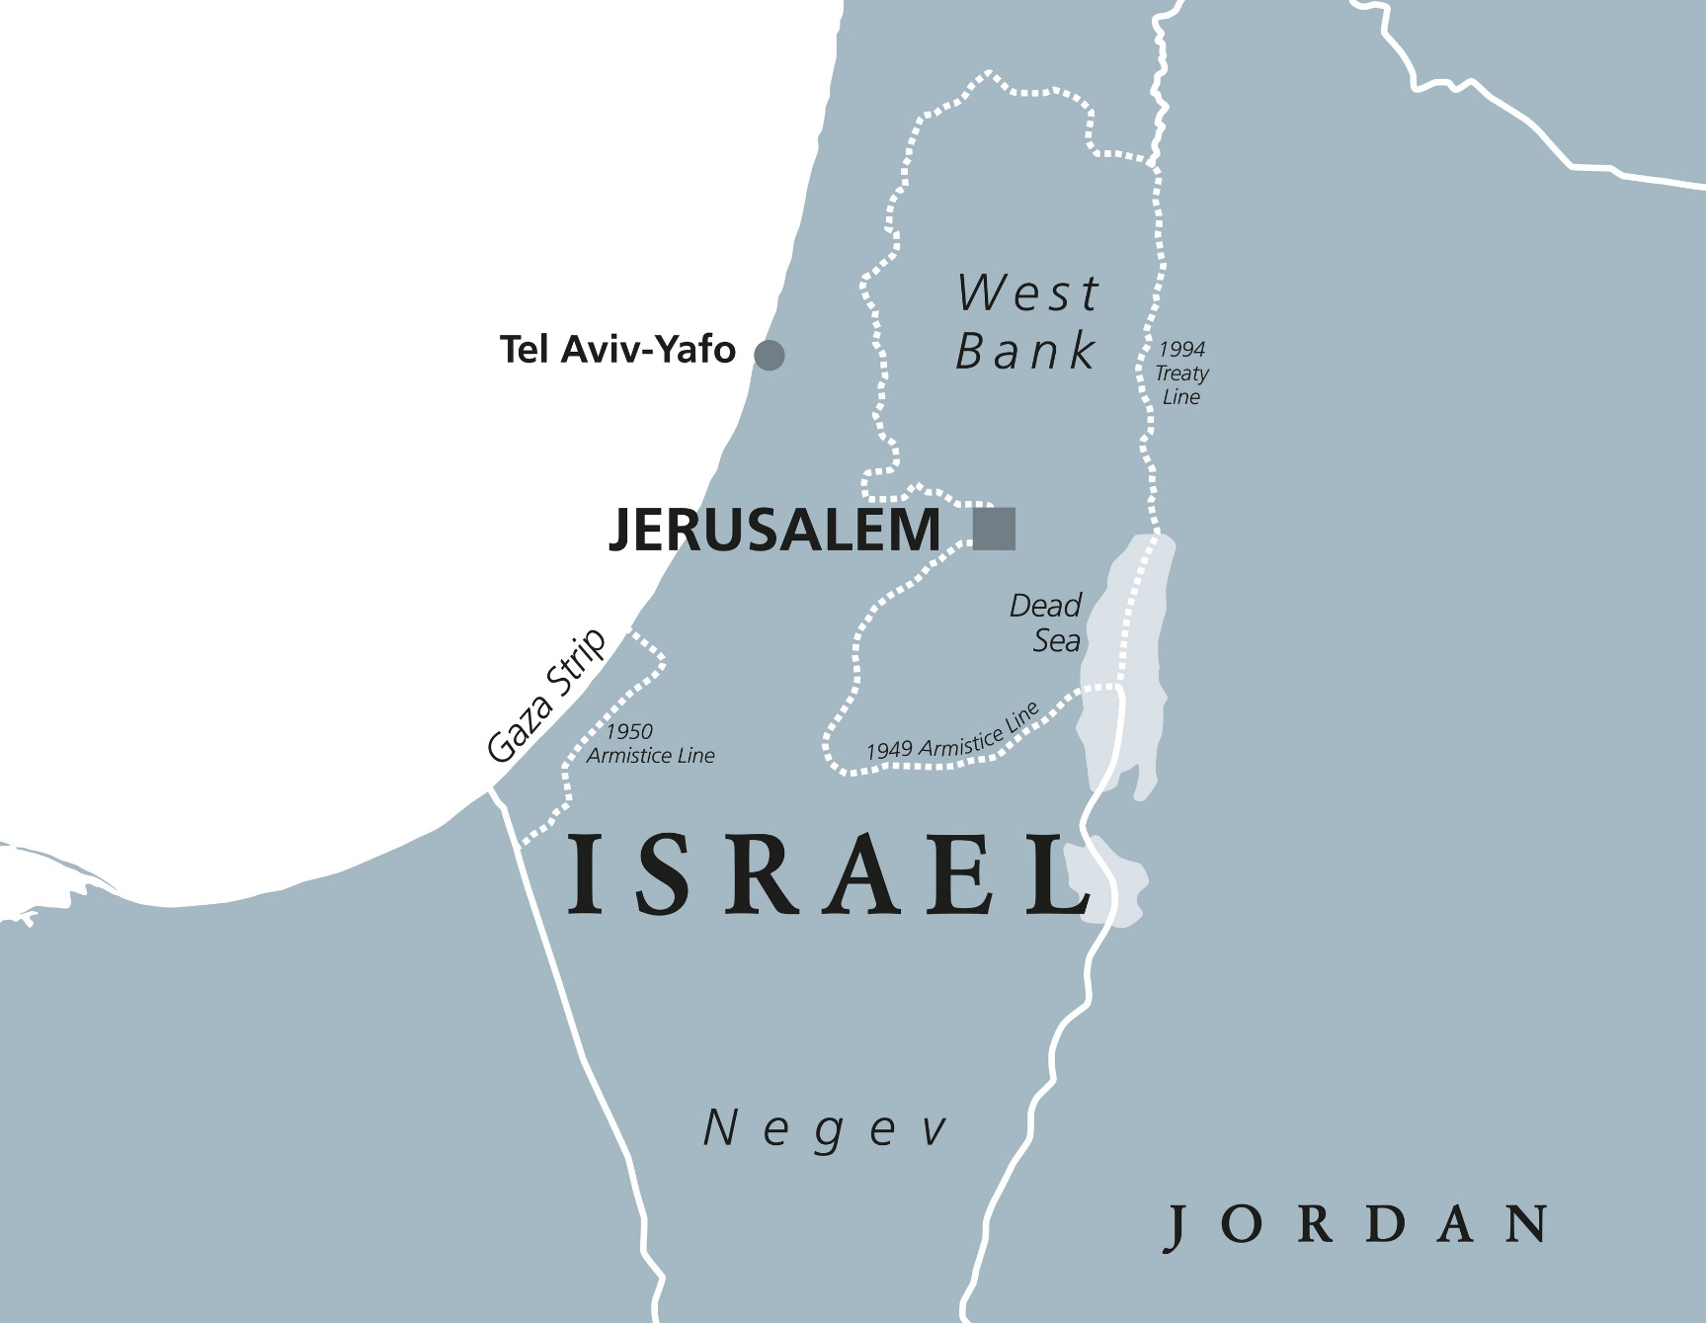
Which country is on-track to achieve herd immunity?

Slide 18
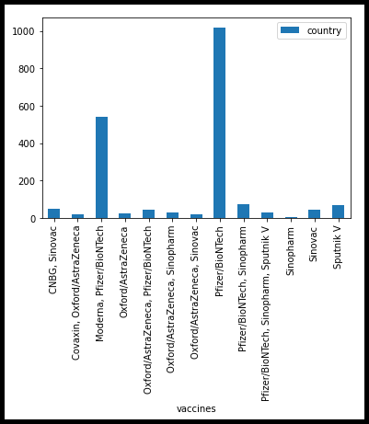
Which country is the most successful in rolling out the COVID-19 vaccine and what vaccines are they using?

Slide 19
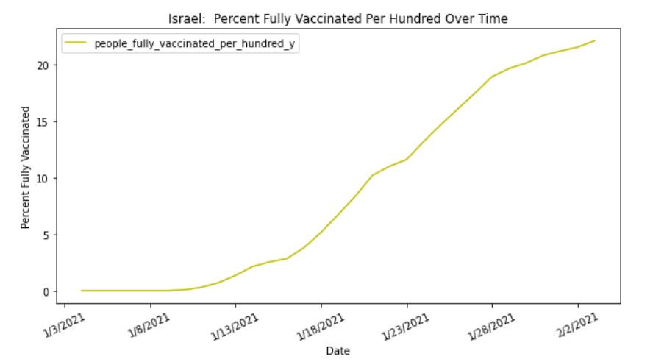
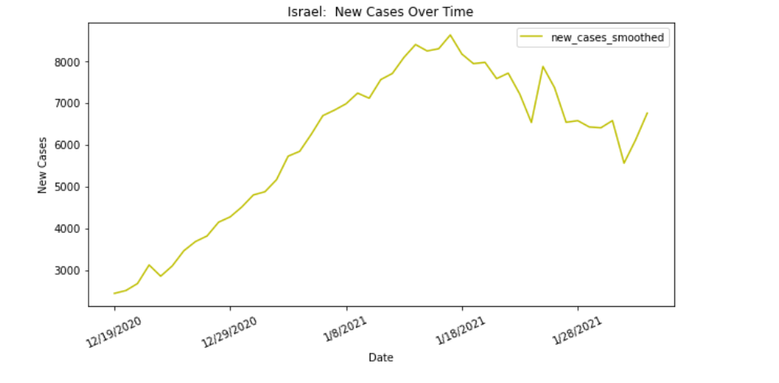
For the top country, ISRAel, does a correlation exist between percent of people vaccinated and number of new cases?

Slide 20
Implications

Slide 21

Implications
Herd Immunity is much talked about but very difficult to achieve.
Early discussions among in the course of pandemic believed that a 75% immunity rate was the herd immunity target.
Today, that rate may be closer to 90%.
This study indicates that those countries who wish to attempt to achieve herd immunity have the nation of ISRAEL to look to as a model for mass vaccinations.
Source: https://www.nytimes.com/2020/12/24/health/herd-immunity-covid-coronavirus.html

Slide 22

Further Research
Create a world map to track coronavirus case and vaccination rates
Disaggregate the data for urban vs rural nation
Determine Correlation between GDP and case/vaccination rates.

